Slide 1
Predicting Survival in Patients with Heart Failure by Zulu Healthcare Analytics

Slide 2
Client and Objectives
Who: Faisalabad Institute of Cardiology and Allied Hospital in Faisalabad
Problem: Can we predict survival in patients with heart failure? Can we identify the most important features?

Slide 3
Data
Data source:
UCI Machine Learning Repository
Originated: Faisalabad Institute of Cardiology and Allied Hospital in Faisalabad (Pakistan) in 2015.
299 records
(heart failure patients)
13 Features

Slide 4
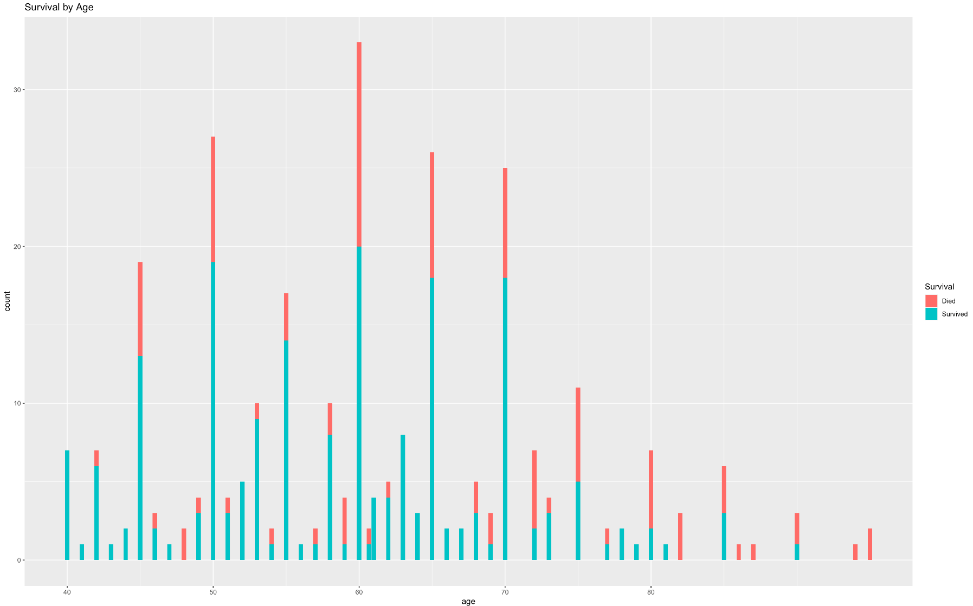
Data Exploration
Survival by Age

Slide 5
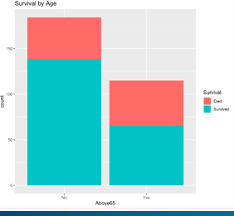
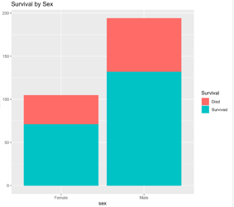
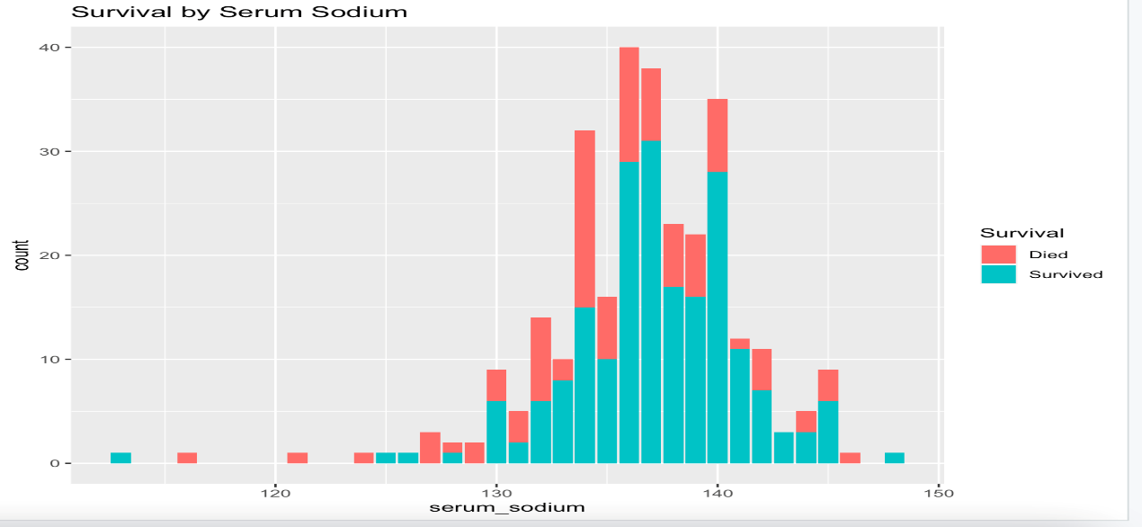
Data Exploration cont.

Slide 6
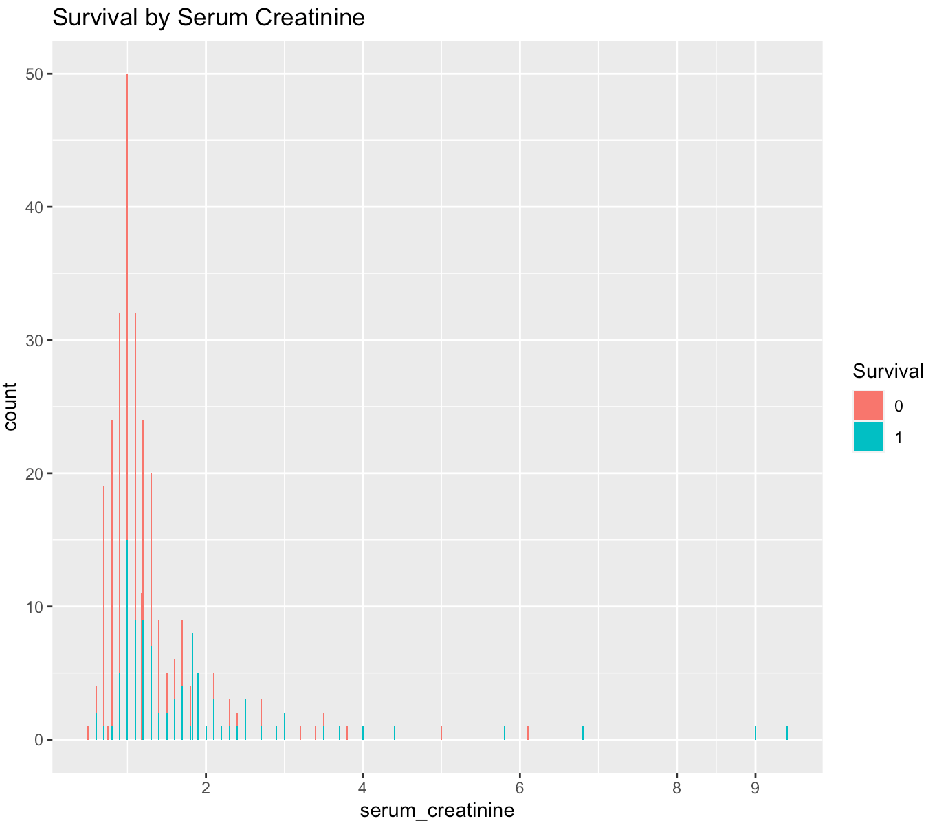
Data Exploration cont.

Slide 7
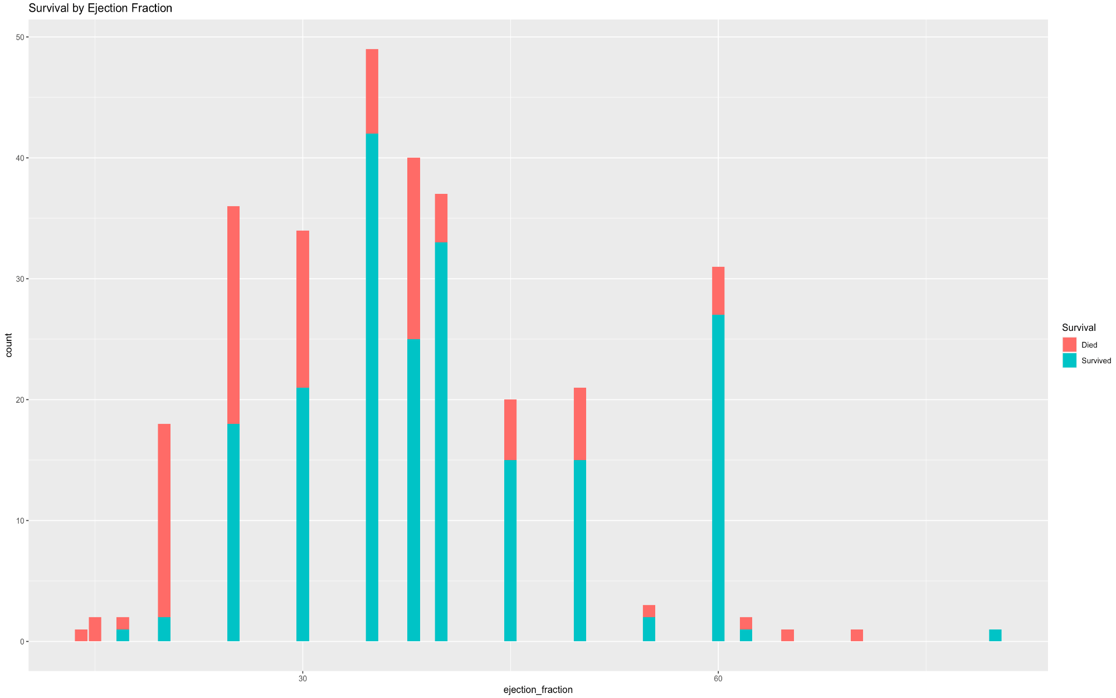
Data Exploration cont.
Survival by Ejection Fraction

Slide 8
Preprocessing & Feature Selection
6 features into factors
Age group
Removed the feature ‘time’
No missing values
Imbalanced data (ROSE – Training Set)
Boruta for feature selection
Notes:
Boruta is an all relevant feature selection wrapper algorithm, capable of working with any classification method that output variable importance measure (VIM); by default, Boruta uses Random Forest. The method performs a top-down search for relevant features by comparing original attributes’ importance with importance achievable at random, estimated using their permuted copies, and progressively eliminating irrelevant features to stabilize that test.

Slide 9
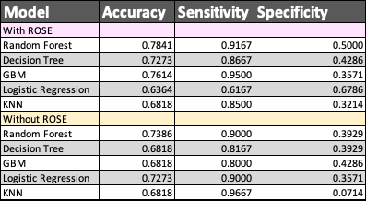
Model Comparison
Notes:
ROSE (Random Over-Sampling Examples) aids the task of binary classification in the presence of rare classes.
It produces a synthetic, possibly balanced, sample of data simulated according to a smoothed-bootstrap approach.

Slide 10
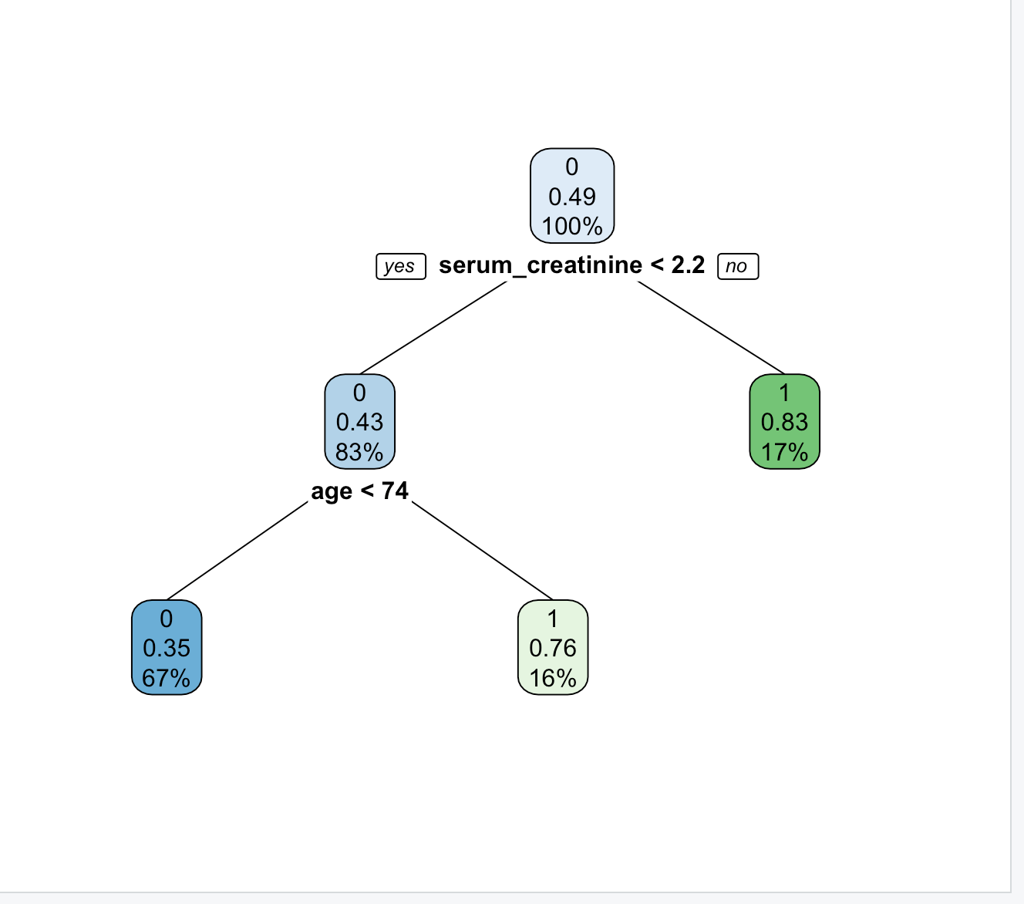
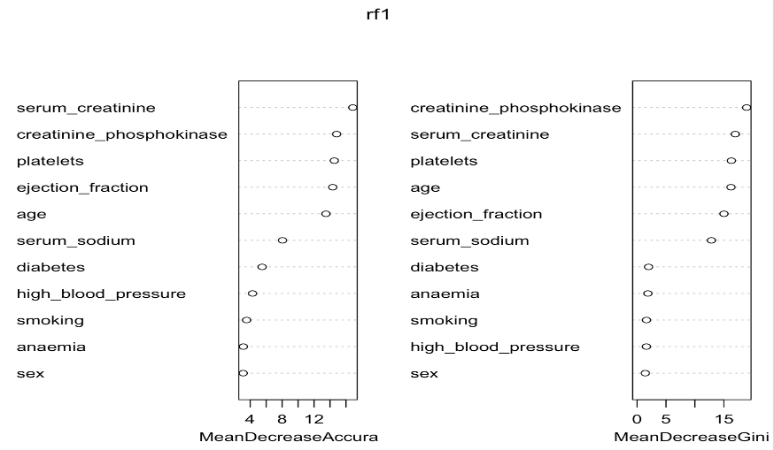
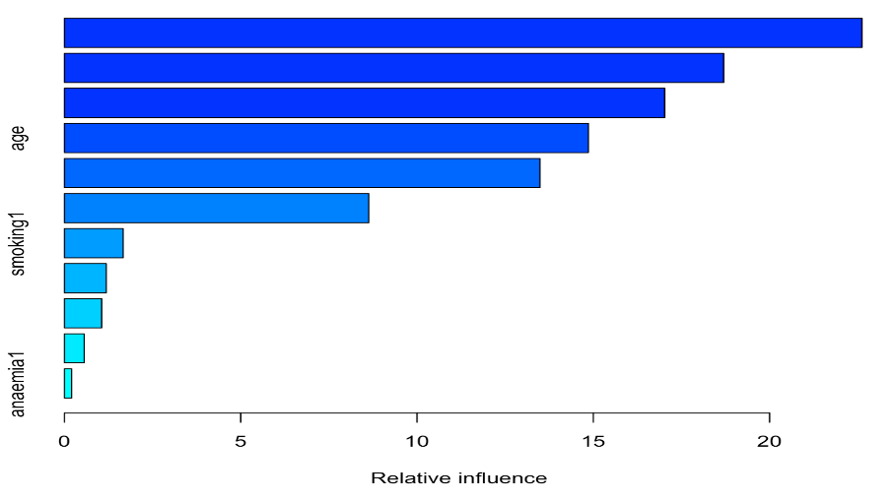
Model Evaluation
Decision Tree
A new data set was created with the top 6 features.
Random Forest
GBM

Slide 11
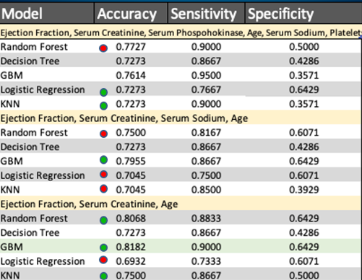
Results
(Boruta)

Slide 12
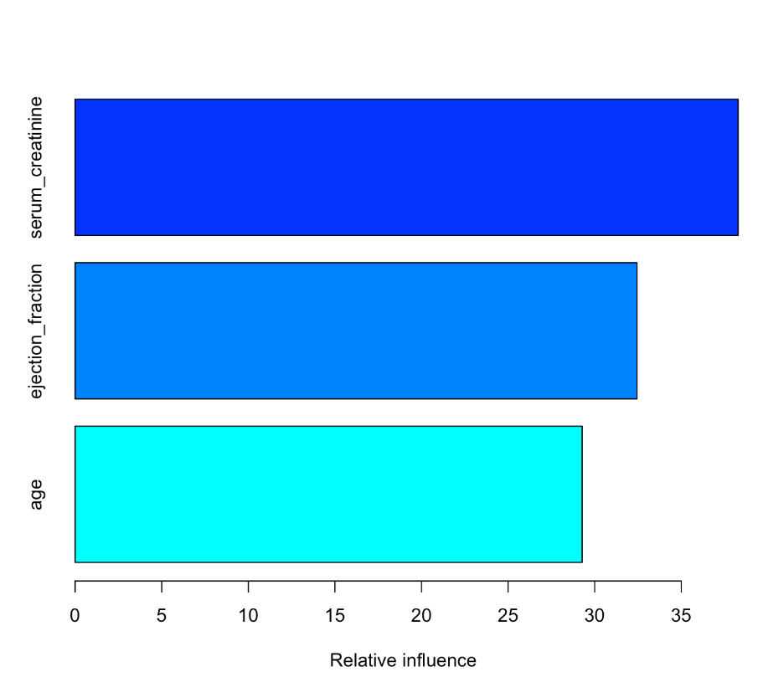
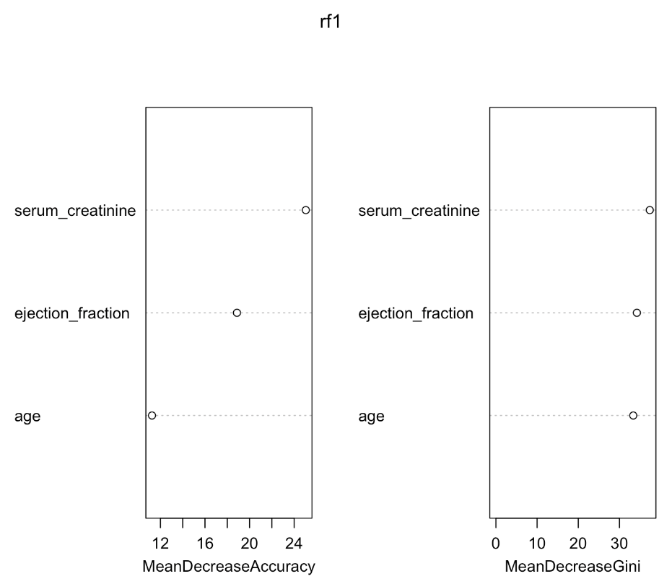
Results
GBM
Random Forest

Slide 13


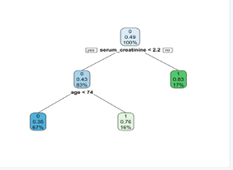
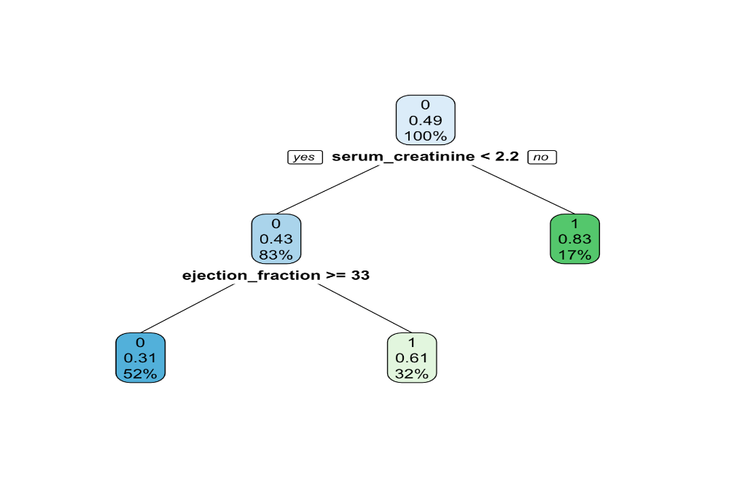
Results

Slide 14
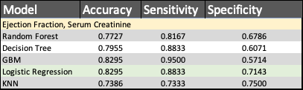
Results

Slide 15
Conclusion
ML models can predict survival of patients with heart failure.
Most important features:
Serum Creatinine
Ejection Fraction

Slide 16
Limitations
The sample size is relatively small.
Additional patient information could be useful to the study such as body mass index, alcohol use, other medical conditions, genetic history, medications, and occupational history.

Slide 17
Research & Cited Work
Mayo Clinic. ‘Heart Failure”. 1998 -2022. https://www.mayoclinic.org/diseases-conditions/heart-failure/symptoms-causes/syc-20373142
Package ‘Boruta’. 2020. https://cran.r-project.org/web/packages/Boruta/Boruta.pdf
Package ‘ROSE’. 2021. https://cran.r-project.org/web/packages/ROSE/ROSE.pdf
UCI Machine Learning Repository. Tanvir Ahmad, Assia Munir, Sajjad Haider Bhatti, Muhammad Aftab, and Muhammad Ali Raza. 2020. UCI Machine Learning Repository: Heart failure clinical records Data Set.

Slide 18

Questions or Comments?

Slide 19
Code Examples
#balance dataset
data_rose <- ROSE(Survival ~., data = TrainingSet)$data
table(data_rose$Survival)
#Feature selection
boruta <- Boruta(Survival~., data = new_data, doTrace = 2, maxRuns = 500)
print(boruta)

Slide 20
